Slide 1
ANP101: INTRODUCTORY ANIMAL PHYSIOLOGY (2 UNITS)
Course Outline
Characteristics of living things; Cellular basis of life: Cell organelles; Cell cycle, Cell division, Cell growth, Cell death.
Classification of Animal Kingdom, Grades of Organisation, A brief introduction of the various Animal Phyla: Protozoa, Coelenterata, Porifera, Platyhelminthes, Nematoda, Annelida, Mollusca, Arthropoda, Echinodermata, and Chordata.

Slide 2
Prokaryotes and Eukaryotes
2 general categories of cells:
Prokaryotes – Organisms that lack a nuclear membrane, e.g. Bacteria
Unicellular organisms, never differentiate into multi-cellular forms
Lack cell organelles; plasma membrane performs most of the functions of cell organelles.
Consist of 3 parts:
Flagella and pili which are proteins attached to the cell surface
Cell envelope consisting of a cell wall, a plasma membrane, and
Cytoplasmic region containing the cell genome (DNA), ribosomes, etc.

Slide 3
Prokaryotes and Eukaryotes, contd.
Eukaryotes – Include fungi, animals, plants, and some unicellular organisms;
about 10 x the size of prokaryotes and can be up to 1,000 x greater in volume
Contain membrane-bound compartments in which specific metabolic activities take place
Has a Nucleus – a membrane-bound compartment which contains the cell’s DNA
Have other specialized structures called Organelles: Small structures within cells, performing dedicated functions.

Slide 4
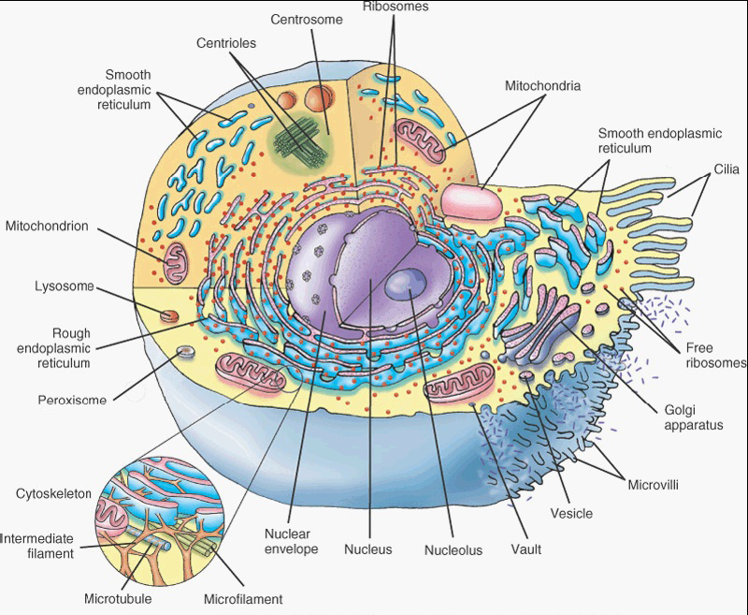
EXAMPLE OF A EUKARYOTIC CELL

Slide 5
The Plasma Membrane
Outer lining of the cell.
Separates and protects the cell from its surrounding environment
Made up of a double layer of lipid molecules and protein
Embedded proteins act as channels and pumps moving molecules in and out of the cell.
A form of plasma membrane found in prokaryotes is usually called the cell membrane.

Slide 6
The Cytoskeleton
Complex and dynamic cell component
Acts to organize and maintain the cell’s shape
Anchors organelles in place
Helps during endocytosis – the uptake of external materials by a cell
Moves parts of the cell in processes of growth and motility
A great number of proteins are associated with the cytoskeleton, controlling a cell’s structure by directing, bundling and aligning filaments.

Slide 7
The Cytoplasm
Internal, fluid-filled space of the cell
Also called The Cytosol
In eukaryotes all cell organelles reside in the cytosol
It is also home to the cytoskeleton
Contains dissolved nutrients
Helps to break down waste products
Moves materials around the cell through a process known as cytoplasmic streaming
Contains many salts and is an excellent conductor of electricity.

Slide 8
The Nucleus
Most conspicuous organelle found in eukaryotic cell
Contains the cell’s chromosomes
Place where almost all DNA replication and RNA synthesis occurs
Spheroid in shape and separated from the cytosol by the nuclear membrane
Nuclear membrane isolates and protects a cell’s DNA from molecules that could accidentally damage its structure or interfere with its processes.
DNA is transcribed, forming Messenger RNA (mRNA)
mRNA is transported to the cytosol where it is translated into a specific protein molecule
In prokaryotes, DNA processing takes place in the cytoplasm.

Slide 9
The Ribosome
Found in both prokaryotes and eukaryotes
Composed of large complex molecules, including RNAs and Proteins
Responsible for processing genetic instructions carried by a mRNA
Process of converting the genetic code carried by a mRNA into the correct sequence of amino acids that make up a protein is called Translation
There are usually large numbers of ribosomes in a cell as protein synthesis is extremely important for proper functioning of cells
Ribosomes float freely in the cytosol but are sometimes bound to the endoplasmic reticulum
Ribosomes comprise of one large and one small subunit, each having a different function during protein synthesis

Slide 10
Mitochondria
Self-replicating organelles found in cytoplasm of all eukaryotic cells
Occur in various numbers, shapes and sizes
They contain their own genome separate and distinct from the nuclear genome of a cell
Have 2 functionally distinct membrane systems separated by a space:
Outer membrane which surrounds the whole organelle, and
Inner membrane which form folds called Cristae
Number and shape of cristae in mitochondria vary with tissue and organism in which they are found

Slide 11
Glycolysis
Play critical role in generating energy in eukaryotic cell; process involves complex pathways
Glycolysis (1st pathway) requires no oxygen and is referred to as anaerobic metabolism
Occurs in the cytoplasm, outside the mitochondria
Glucose is broken down into pyruvate; each reaction produces some hydrogen ions which are then used to make ATP
4 molecules of ATP are made from one molecule of glucose in glycolysis
In prokaryotes, glycolysis is the only pathway used for converting energy

Slide 12
Kreb’s cycle or Citric acid cycle
Kreb’s cycle or Citric acid cycle:
Occurs inside the mitochondria
Capable of generating enough ATP to run all the cell functions
Cycle begins with glucose molecule which is stripped of some of its hydrogen atoms to form two molecules of pyruvic acid
Next, pyruvic acid is altered by removal of a carbon and 2 oxygen atoms which form CO₂
When the CO2 is removed, energy is given off and a molecule of NAD+ is converted into the higher energy form, NADH.
Another molecule, coenzyme A, then attaches to the remaining acetyl unit to form acetyl CoA
Acetyl CoA joins a 4-carbon molecule (oxaloacetate) to form citric acid, a 6-carbon molecule

Slide 13
Kreb’s cycle or Citric acid cycle, contd.
Citric acid is broken down and modified in a step-wise fashion, a process leading to the release of hydrogen ions and carbon molecules
The carbon molecules are used to make more carbon dioxide
The hydrogen ions are picked up by NAD and FAD (flavin-adenine dinucleotide)
Eventually oxalate is again produced and the process starts again.
Kreb’s cycle is capable of generating between 24 and 28 ATP molecules from one glucose molecule converted to pyruvate.

Slide 14
Chloroplasts and Mitochondria
Chloroplasts are similar to mitochondria but are found only in plants
Both are surrounded by a double membrane with an inter-membrane space
Both have their own DNA
Both are involved in energy metabolism
Both have reticulations or foldings filling their inner space
Chloroplasts convert light energy from the sun into ATP through photosynthesis

Slide 15
Endoplasmic reticulum and Golgi apparatus
Endoplasmic reticulum (ER) – the transport network for molecules targeted for certain modifications and specific destinations within the cytoplasm
Two forms: Rough ER and Smooth ER.
Rough ER – has ribosomes adhering to its outer surface
Smooth ER – has no adhering ribosomes
Translation of the mRNA for proteins that will either stay in the ER or exported occurs at the ribosomes attached to the RER.
The SER serves as the recipient for proteins synthesized in the RER.
Proteins for export are passed to the Golgi body for further processing, packaging and transport to other cellular locations.

Slide 16
Lysosomes and Peroxisomes
Both organelles are spherical, bound by a single membrane and rich in digestive enzymes.
Lysosomes contain >36 enzymes for degrading proteins, nucleic acids and polysaccharides. These enzymes are most active at low pH, reducing the risk of autolysis.
This shows the importance of compartmentalization in eukaryotic cells.
Peroxisomes often resemble a lysosome, but:
Peroxisomes are self-replicating while lysosomes are formed in the Golgi complex
Peroxisomes also have membrane proteins which are critical for various functions, such as importing proteins into their interiors and to proliferate and segregate into daughter cells.

Slide 17
Lysosomes and Peroxisomes, contd.
Functions of lysosome:
Digests foreign bacteria that invade a cell
Helps to recycle receptor proteins and other membrane components
Degrades worn out organelles such as mitochondria
Can help repair damage to the plasma membrane by serving as a membrane patch, sealing the wound.

Slide 18
Lysosomes and Peroxisomes, contd.
Functions of peroxisome:
Rids the body of toxic substances such as hydrogen peroxide or other metabolites
Contain enzymes concerned with oxygen utilization
Present in high numbers in the liver where toxic byproducts are known to accumulate
All enzymes found in a peroxisome are imported from the cytosol
Each enzyme transferred to a peroxisome has a special sequence at one end of the protein, called peroxisomal targeting signal (PTS)
PTS allows the protein to be taken into that organelle, where they rid the cell of toxic substances.

Slide 19
THE CELL CYCLE
Cell cycle: Sequence of events which occurs between one cell division and the next.
It has 3 stages:
1) Interphase
period of synthesis and growth
Cell produces many materials required for its own growth and for carrying out all its functions
DNA replication occurs during this stage
2) Mitosis
Process by which the cell nucleus divides to produce 2 daughter nuclei containing identical sets of chromosomes to the parent cell
3) Cell division
Process of division of the cytoplasm into 2 daughter cells

Slide 20
PROPHASE
MITOSIS
METAPHASE
ANAPHASE
G1 + S + G2 = CELLULAR SYNTHESIS
TELOPHASE
G₂
CELL DIVISION
S
M
INTERPHASE
G₁
THE CELL CYCLE CHART

Slide 21
Key to the Cell Cycle chart
Phase | Events within cell
G₁ | Intensive cellular synthesis, including cell organelles. Cell metabolic rate high. Cell growth occurs. Substances produced to inhibit or stimulate onset of next phase as appropriate.
S | DNA replication occurs. Protein molecules called histones are synthesized and cover each DNA strand. Each chromosome becomes two chromatids. At this stage the cell is 4n (4 copies of each DNA molecule, 2 in each homologous chromosome).
G₂ | Intensive cellular synthesis. Mitochondria and chloroplasts divide. Energy stores increase. Mitotic spindle begins to form.
M | Nuclear division occurs in 4 phases.
C | Equal distribution of organelles and cytoplasm into each daughter cell.

Slide 22
MITOSIS
Interphase
Varies in duration depending on the function of the cell
DNA of each chromosome replicates just before nuclear division
Each chromosome now exists as a pair of chromatids joined together by a centromere
The cell is 4n at this stage (4 copies of each DNA molecule, 2 in each chromosome of a homologous pair
During this phase chromosome material is in the form of very loosely coiled threads called chromatin
Centrioles have replicated.
Prophase
This is usually the longest phase of division
Chromosomes shorten and thicken by coiling and tighter packaging of their components
In animal cells the centrioles move to opposite poles of the cell
Short microtubules called asters may be seen radiating from the centrioles
The nucleoli disappear as their DNA passes to certain chromosomes.
The nuclear envelope breaks up into small vesicles which disperse.
A spindle is formed.

Slide 23
Mitosis contd.
Metaphase
Chromosomes line up around the equator of the spindle
They are attached by their centromeres to the spindle fibres which are microtubules
Anaphase
Very rapid stage
Centromeres split in 2
Spindle fibres pull the daughter centromeres to opposite poles
Separated chromatids are pulled along behind the centromeres
Telophase
Chromatids reach the poles of the cell
They uncoil and lengthen to form chromatin again, losing visibility
Spindle fibres disintegrate
Centrioles replicate
A nuclear envelope reforms around the chromosomes at each pole
Nucleoli reappear

Slide 24
Mitosis contd.
Cytokinesis
Cytokinesis is the division of the cytoplasm
Normally follows telophase and leads into the G1 phase of interphase
In preparation for cell division, cell organelles become evenly distributed towards the 2 poles of the telophase cell along with the chromosomes
In animal cells the cell surface membrane starts to invaginate towards the region previously occupied by the spindle equator
Microtubules probably draw in the cell surface membrane to form a furrow around the outer surface of the cell
Cell surface membranes in the furrow eventually join up to completely separate the 2 cells.
Significance of mitosis
Genetic stability
Growth
Cell replacement
Regeneration
Asexual reproduction

Slide 25
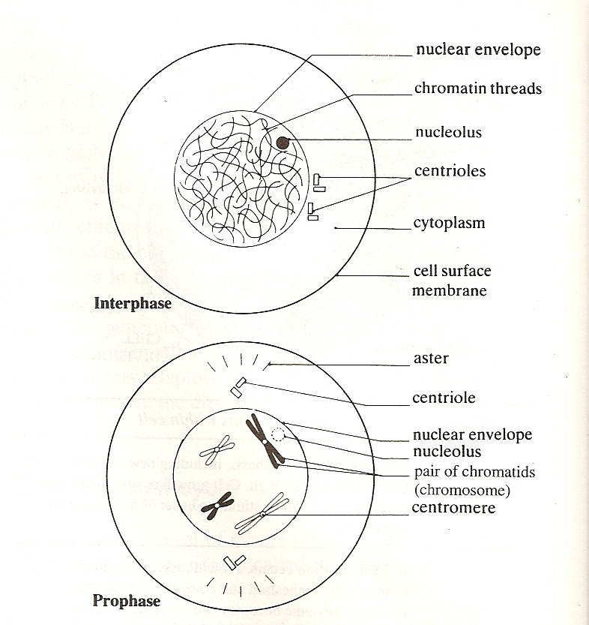

Slide 26
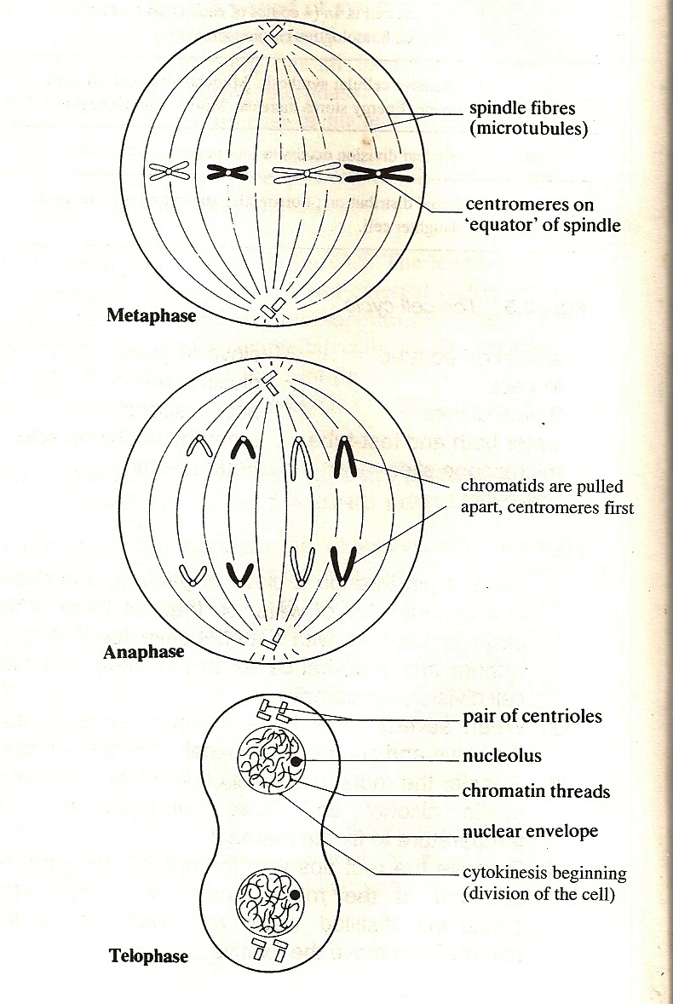

Slide 27
MEIOSIS
Form of nuclear division in which the chromosome number is halved from the diploid number (2n) to the haploid number (n)
Like mitosis, it involves DNA replication during interphase in the parent cell
This is followed by 2 cycles of nuclear divisions and cell divisions known as meiosis I (the 1st meiotic division) and meiosis II (the 2nd meiotic division)
Thus a single diploid cell gives rise to 4 haploid cells
Meiosis occurs during the formation of sperm and eggs in animals.

Slide 28
Meiosis I
Prophase I
Chromosomes shorten and become visible
Homologous chromosomes pair up in a process called synapsis
Each pair is called a bivalent
One of the pair comes from the male parent and one from the female parent
The homologous chromosomes appear to repel each other and partially separate
Each chromosome is now seen to be composed of 2 chromatids
The 2 chromosomes are seen to be joined at several points along their length, called chiasmata
Each chiasma is the site of an exchange between chromatids
Genes from one chromosome (e.g. paternal) may swap with genes from the other (maternal) leading to new gene combinations in the resulting chromatids: This is called crossing over.

Slide 29
Meiosis I, contd.
Metaphase I
The bivalents become arranged around the equator of the spindle, attached by their centromeres
Anaphase I
Spindle fibres pull homologous chromosomes, centromeres first, towards opposite poles of the spindle
Chromosomes are separated into 2 haploid sets, one at each end of the spindle

Slide 30
Meiosis I, contd.
Telophase I
Arrival of homologous chromosomes at opposite poles marks the end of meiosis I
Halving of chromosome number has occurred but the chromosomes are still composed of 2 chromatids
Spindle fibres usually disappear
The chromatids uncoil and a nuclear envelope re-forms at each pole and the nucleus enters interphase
Cleavage occurs as in mitosis
Interphase II
Present only in animal cells
Varies in duration
No further DNA replication occurs.

Slide 31
Meiosis II
Meiosis II is similar to mitosis
Prophase II
Stage is absent if interphase II is absent
Nucleoli and nuclear envelope disperse
Chromatids shorten and thicken
Centrioles move to opposite poles of the cells
At the end of the phase spindle fibres appear, arranged at right angles to the spindle of meiosis I
Metaphase II
Chromosomes line up separately around the equator of the spindle
Anaphase II
Centromeres divide
Spindle fibres pull the chromatids to opposite poles, centromeres first

Slide 32
Meiosis II, contd.
Telophase II
4 haploid daughter cells are formed
Chromosomes uncoil, lengthen and become indistinct
Spindle fibres disappear
Centrioles replicate
Nuclear envelopes re-form around each nucleus
Each nucleus now contains haploid number of chromosomes
Cleavage formation results in production of 4 daughter cells.

Slide 33
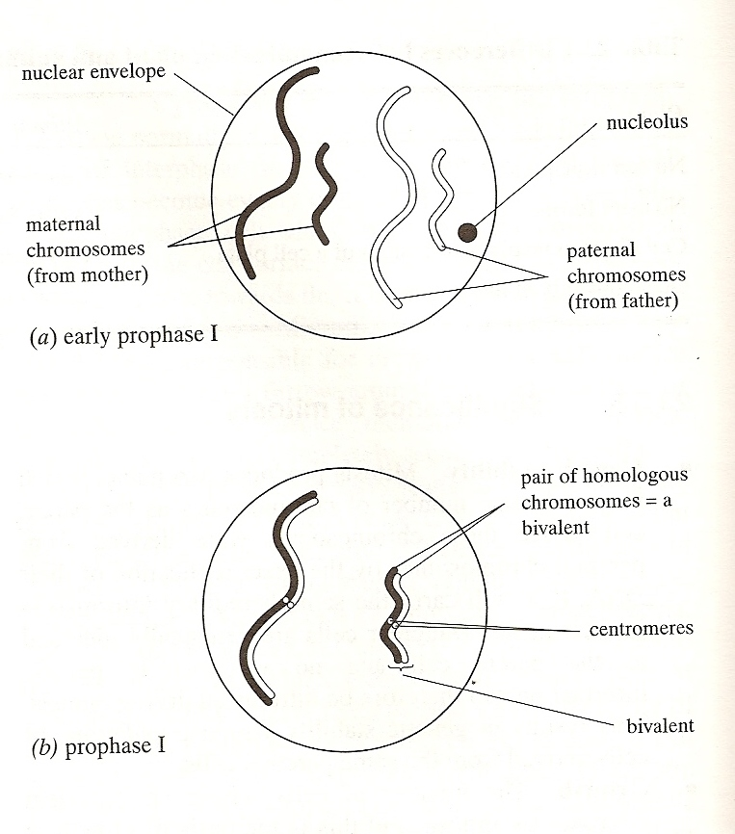

Slide 34
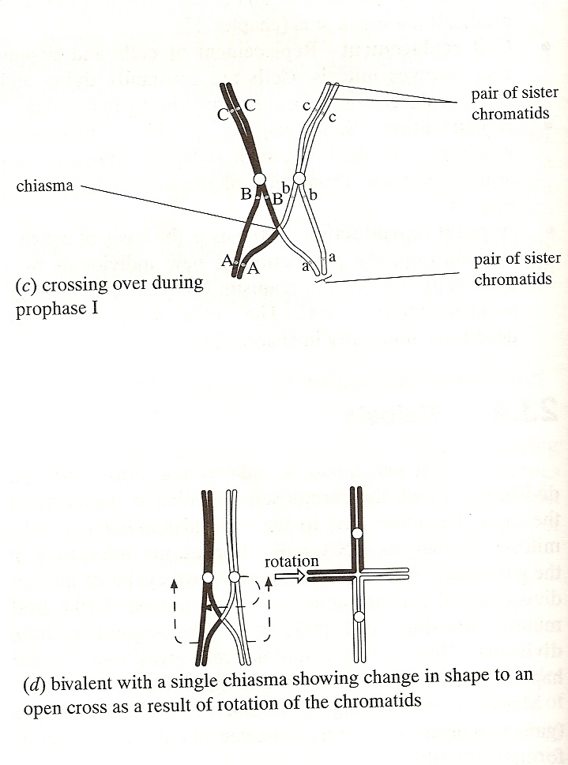

Slide 35
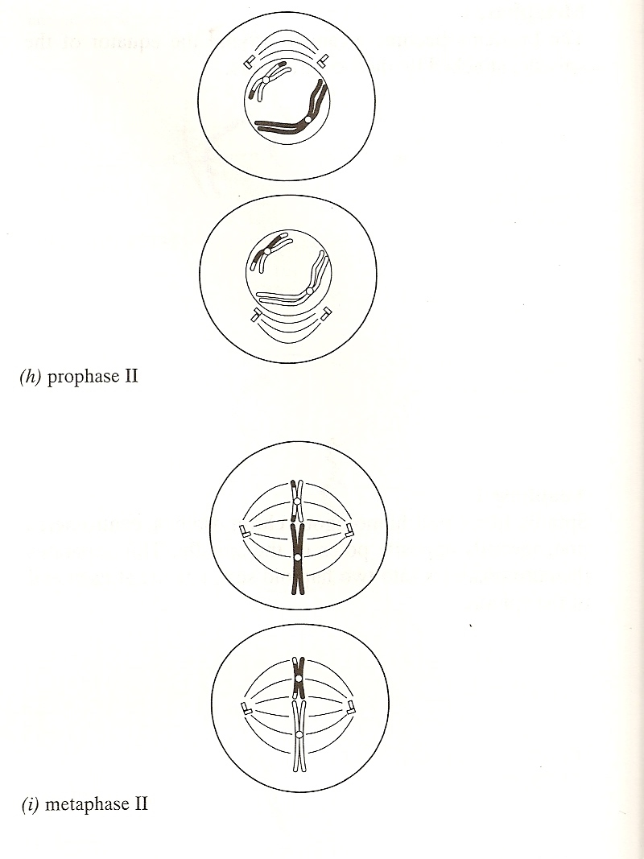

Slide 36
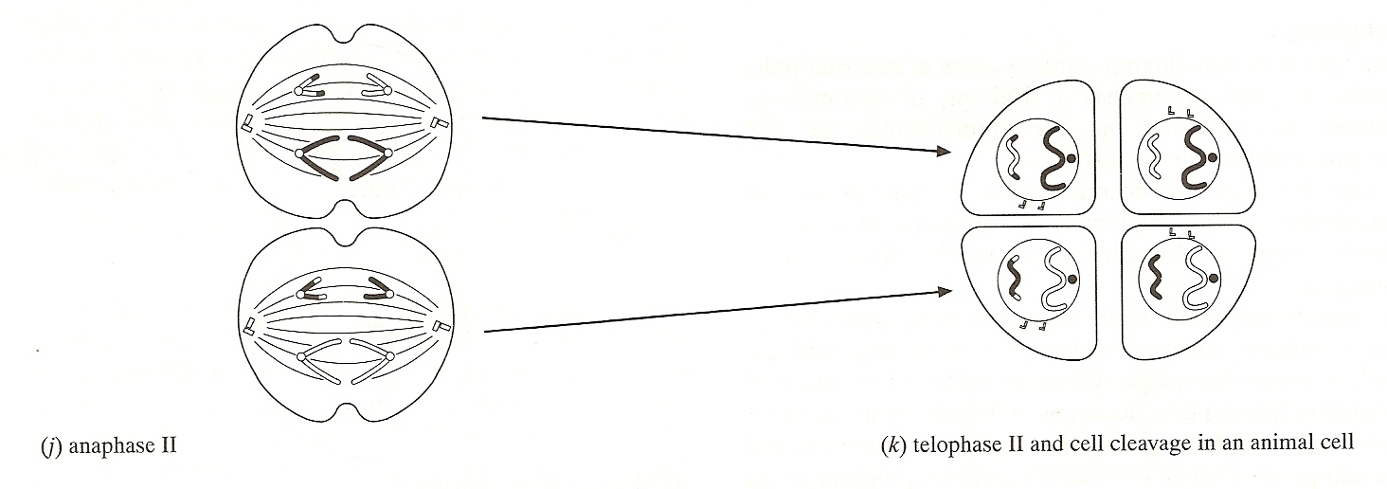

Slide 37
CELL ADAPTATION, CELL INJURY and CELL DEATH
I. DEFINITIONS AND TERMINOLOGY
1) Homeostasis
Cells are able to maintain normal structure and function (e.g. ion balance, pH, energy metabolism) in response to normal physiologic demands.

Slide 38
CELL ADAPTATION, CELL INJURY and CELL DEATH contd…
2) Cellular Adaptation
As cells encounter stresses, either excessive physiologic demand or some pathologic stimuli, they may make functional or structural adaptations to maintain viability / homeostasis.
Cells may respond to these stimuli by either increasing or decreasing their content of specific organelles.
Adaptive processes: atrophy, hypertrophy, hyperplasia and metaplasia are forms of adaptation.

Slide 39
CELL ADAPTATION, CELL INJURY and CELL DEATH, contd.
3) Cell Injury
If the limits of adaptive response are exceeded, or in certain instances when adaptation is not possible, a sequence of events called cell injury occurs.
a) Reversible Cell Injury
removal of stress will result in complete structural and functional integrity to be restored.

Slide 40
b) Irreversible Cell Injury / Cell Death
if stimulus persists (or severe enough from the start) the cell will suffer irreversible cell injury and death.
cell death is one of the most crucial events in pathology and can affect any type of cell.
two principle morphologic patterns that are indicative of cell death:
Necrosis: type of cell death characterized by severe membrane injury and enzymatic degradation; always a pathologic process.
Apoptosis: regulated form of cell death; can be physiologic or pathologic process.

